Slide 1
Solid State Physics Tutorial I
Engineering Physics

Slide 2
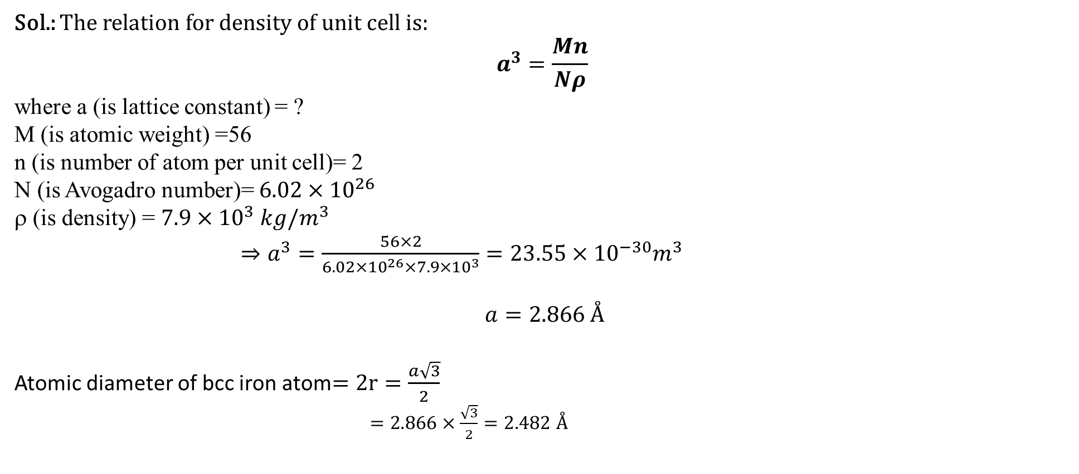
Q1. The density of bcc iron is $7.9×{10}^{3} kg/m^{3}$ and atomic weight is 56. Calculate the size of the unit cell and atomic diameter of iron atom.
Sol.: The relation for density of unit cell is:
$$a^{3}=\frac{Mn}{Nρ}$$
where a (is lattice constant) = ?
M (is atomic weight) =56
n (is number of atom per unit cell)= 2
N (is Avogadro number)= $6.02×{10}^{26}$
ρ (is density) = $7.9×{10}^{3} kg/m^{3}$
$⇒a^{3}=\frac{56×2}{6.02×{10}^{26}×7.9×{10}^{3}}=23.55×{10}^{−30}m^{3}$
$$a=2.866 Å$$
Atomic diameter of bcc iron atom$=2r=\frac{a\sqrt{3}}{2}$
$=2.866×\frac{\sqrt{3}}{2}=2.482 Å$

Slide 3
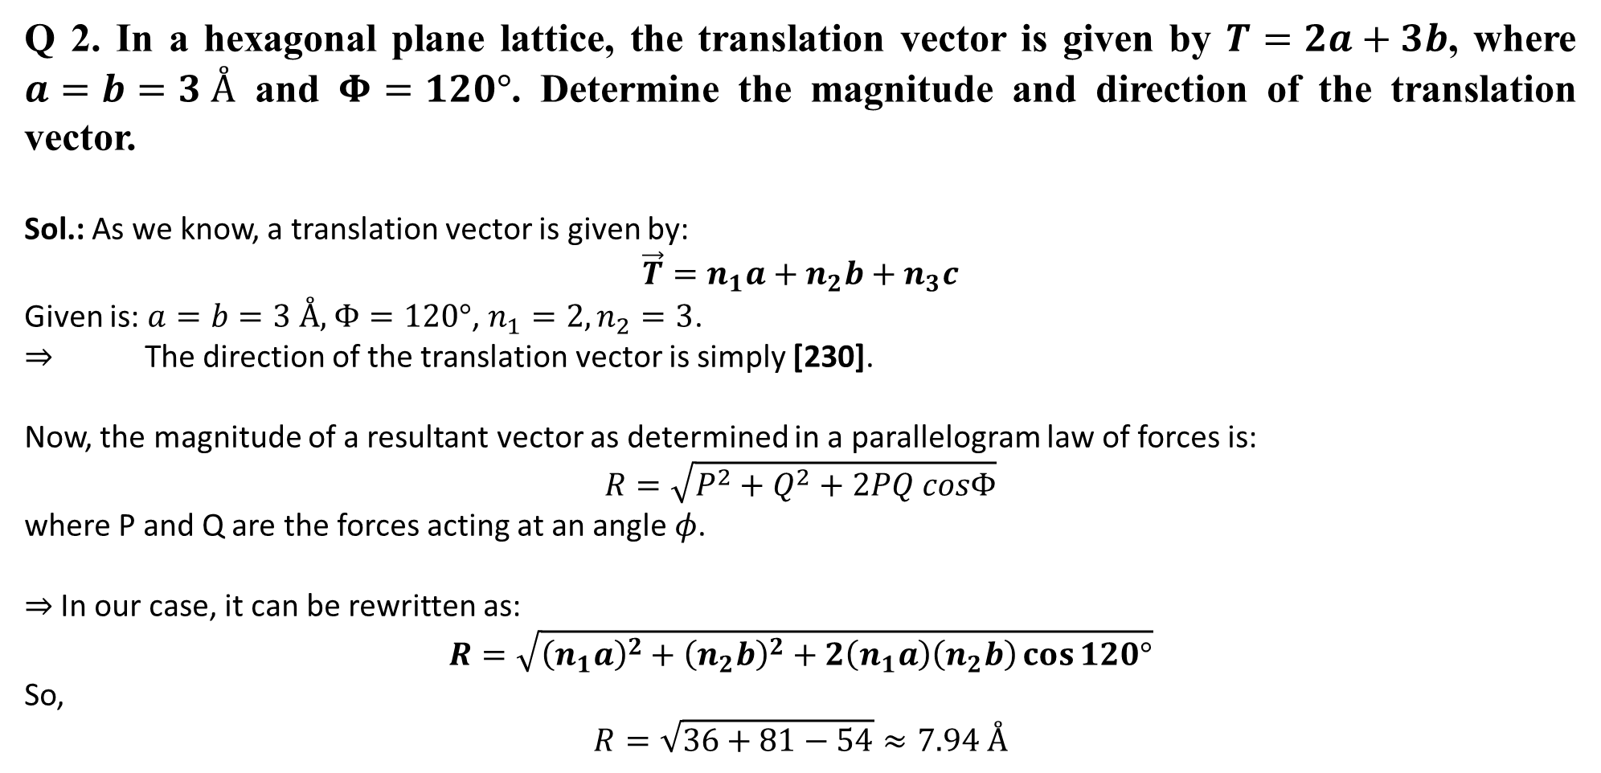
Q 2. In a hexagonal plane lattice, the translation vector is given by $T=2a+3b$, where $a=b=3 Å$ and $Φ=120°$. Determine the magnitude and direction of the translation vector.
Sol.: As we know, a translation vector is given by:
$\vec{T}=n_{1}a+n_{2}b+n_{3}c$
Given is: $a=b=3 Å,$ $Φ=120°$, $n_{1}=2, n_{2}=3$.
$⇒$ The direction of the translation vector is simply [230].
Now, the magnitude of a resultant vector as determined in a parallelogram law of forces is:
$$R=\sqrt{P^{2}+Q^{2}+2PQ cosΦ}$$
where P and Q are the forces acting at an angle $φ$.
$⇒$ In our case, it can be rewritten as:
$$R=\sqrt{{\left(n_{1}a\right)}^{2}+{\left(n_{2}b\right)}^{2}+2\left(n_{1}a\right)\left(n_{2}b\right)\cos{120°}}$$
So,
$$R=\sqrt{36+81−54}≈7.94 Å$$

Slide 4
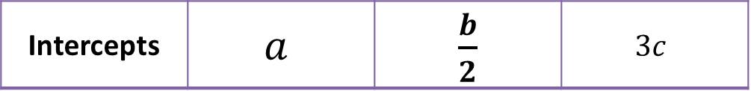
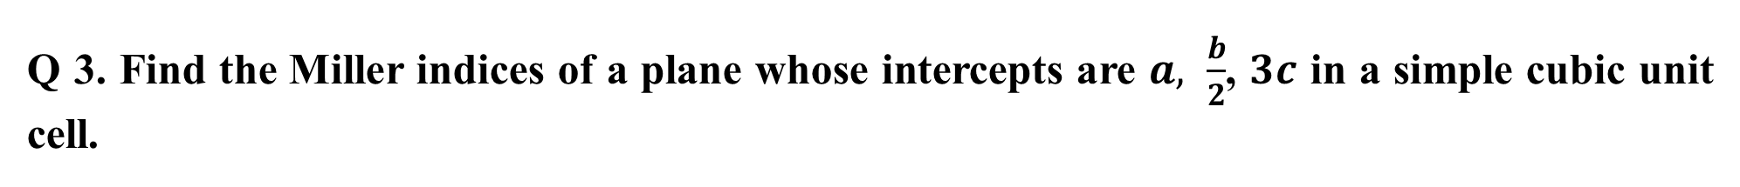

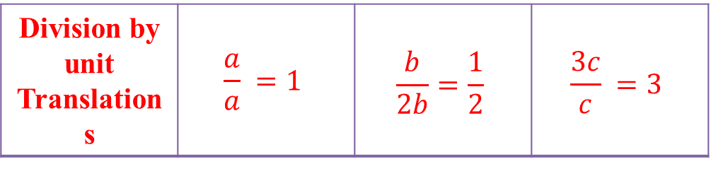
Q 3. Find the Miller indices of a plane whose intercepts are $a, \frac{b}{2}$, $3c$ in a simple cubic unit cell.
Intercepts | $$a$$ | $\frac{b}{2}$ | $$3c$$
Division by unit Translations | $$\frac{a}{a} =1$$ | $$\frac{b}{2b}=\frac{1}{2}$$ | $$\frac{3c}{c} =3$$
Reciprocals | 1 | 2 | $$\frac{1}{3}$$
After clearing Fractions | 3 | 6 | 1
The required Miller indices of the plane are (361) .

Slide 5
Q 4. Determine the Miller indices of a plane that makes intercepts of 2A, 3A, and 4A on the coordinate axes of an orthorhombic crystal with a:b:c=4:3:2
Intercepts 2 3 4
Division by unit 2/4 =1/2 3/3=1 4/2 =2
Translations
Reciprocals 2 1 1/2
After clearing 4 2 1
Fractions
The required Miller indices of the plane are (421) .

Slide 6

Q 7. Calculate the lattice constant of a simple cubic lattice whose interplanar spacing for (110) plane is 3 Å.
Since, $d=\frac{1}{\sqrt{\left\{{\left(\frac{h}{a}\right)}^{2}+{\left(\frac{k}{b}\right)}^{2}+{\left(\frac{l}{c}\right)}^{2}\right\}}}$
For simple cubic lattice, $a=b=c$
$$⇒d=\frac{a}{\sqrt{h^{2}+k^{2}+l^{2}}}$$
$$a=d×\sqrt{h^{2}+k^{2}+l^{2}}$$
$$a=3×\sqrt{1^{2}+1^{2}+0^{2}}$$
$$⇒a=3×\sqrt{2}=4.243 Å$$

Slide 7
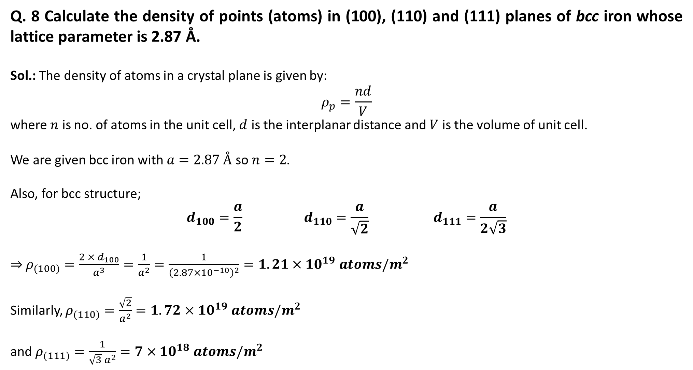
Q. 8 Calculate the density of points (atoms) in (100), (110) and (111) planes of bcc iron whose lattice parameter is 2.87 Å.
Sol.: The density of atoms in a crystal plane is given by:
$$ρ_{p}=\frac{nd}{V}$$
where $n$ is no. of atoms in the unit cell, $d$ is the interplanar distance and $V$ is the volume of unit cell.
We are given bcc iron with $a=2.87 Å$ so $n=2$.
Also, for bcc structure;
$$d_{100}=\frac{a}{2} d_{110}=\frac{a}{\sqrt{2}} d_{111}=\frac{a}{2\sqrt{3}}$$
$⇒$ $ρ_{(100)}=\frac{2 ×{ d}_{100}}{a^{3}}=\frac{1}{a^{2}}=\frac{1}{{\left(2.87×{10}^{−10}\right)}^{2}}=1.21×{10}^{19} atoms/m^{2}$
Similarly, $ρ_{(110)}=\frac{\sqrt{2}}{a^{2}}=1.72×{10}^{19} atoms/m^{2}$
and $ρ_{(111)}=\frac{1}{{\sqrt{3} a}^{2}}=7×{10}^{18} atoms/m^{2}$

Slide 8
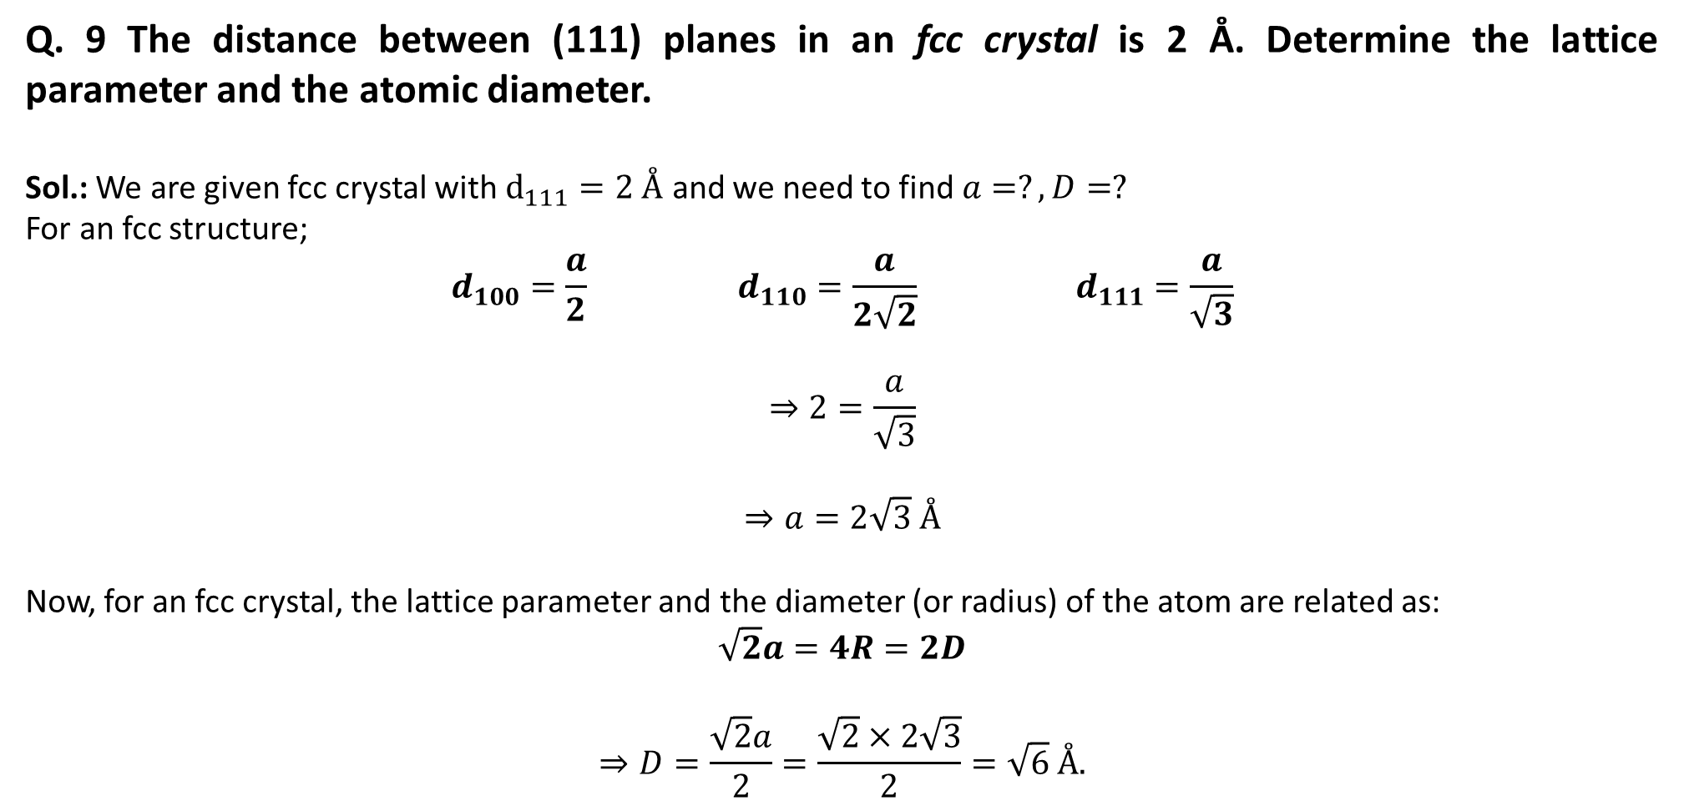
Q. 9 The distance between (111) planes in an fcc crystal is 2 Å. Determine the lattice parameter and the atomic diameter.
Sol.: We are given fcc crystal with $d_{111}=2 Å$ and we need to find $a=?, D=?$
For an fcc structure;
$$d_{100}=\frac{a}{2} d_{110}=\frac{a}{2\sqrt{2}} d_{111}=\frac{a}{\sqrt{3}}$$
$$⇒2=\frac{a}{\sqrt{3}}$$
$$⇒a=2\sqrt{3} Å$$
Now, for an fcc crystal, the lattice parameter and the diameter (or radius) of the atom are related as:
$$\sqrt{2}a=4R=2D$$
$$⇒D=\frac{\sqrt{2}a}{2}=\frac{\sqrt{2}×2\sqrt{3}}{2}=\sqrt{6} Å.$$

Slide 9
!! Home Task !!
Q. 1 Find the radius of the largest sphere that can be fit in the void between the body centered atoms of a bcc crystal structure.
Q. 2 Find the radius of the largest sphere that can be fit at the body centre void of an fcc crystal structure.

